Slide 1
More brain, more Intelligence ???
Laura Maria Dascalescu

Slide 2
Introduction
Here is a topic that fascinated and still fascinates people, myself
Included. Why ? Because many researchers have stated that the size
of the brain determines the amount of intelligence one person has.
Some people may believe that, but some will try to find whether this
statement is indeed true.
We investigated the relationship between brain size and intelligence
by using Factor Analysis and Multivariate Regression Analysis to explain the
relationship between brain size ( MRI_Count ) and the corresponding
intelligence predictors ( independent variables, FSIQ-full scale IQ
Scores, VIQ – verbal IQ scores and PIQ – performance IQ scores ) and
personal characteristics such as Weight and Height.

Slide 3
Factor Analysis Results
Brain size and intelligence are related for both males and females;
Brain size (MRI _Count) is more related to performance scores (PIQ) for
both females and males ;
Brain size is related to height with respect to males;
Brain size is highly related to weight with respect to females;
Note: variables in the same rectangular (quadrant) are correlated;
variables in the same quadrant whose values go over .5 are strongly correlated;
to ascertain the relationship among variables Varimax rotation was used.

Slide 4
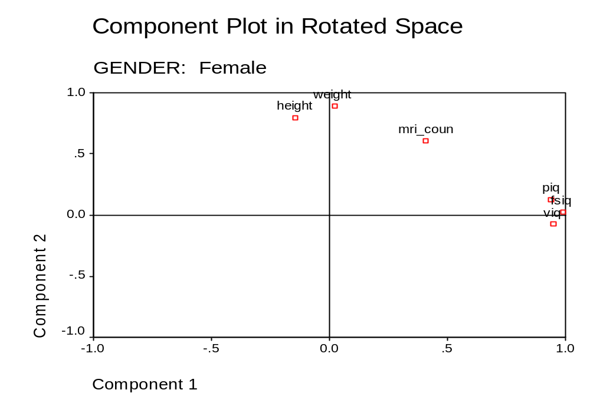

Slide 5
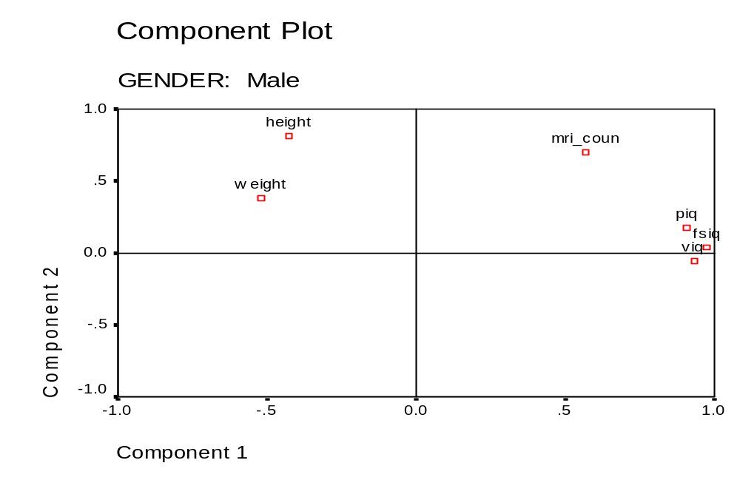

Slide 6
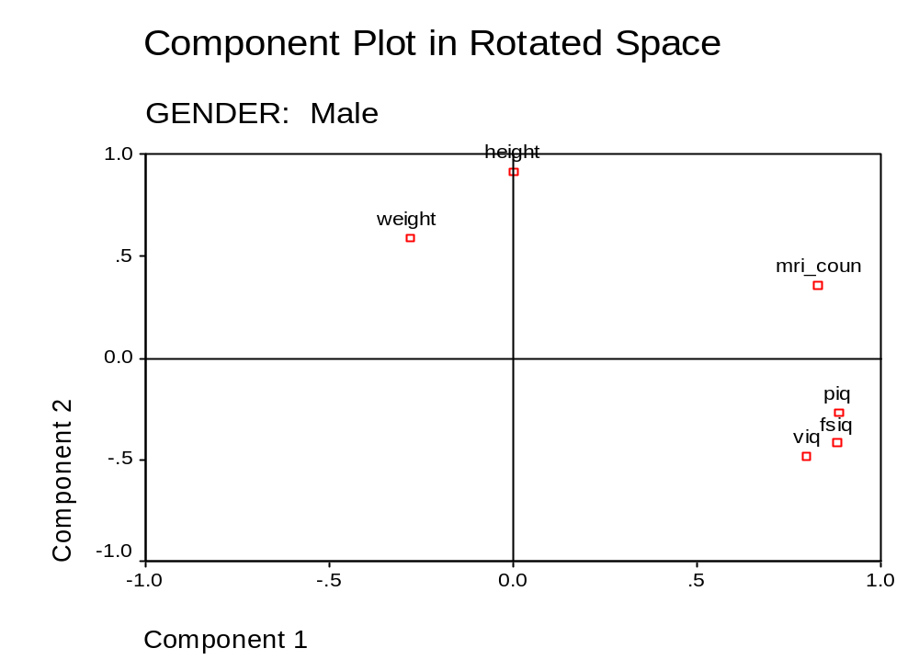

Slide 7
Regression Analysis Results
By looking at the Sig. Values in the last column you probably notice that for females the weight predictor has significance value of .069 , while for males the significance value for height is .139;
what we conclude is that the Brain Size (MRI_ Count ) is related to Weight for females at any significance level of > .069 , while for males Brain Size is related to Height for a significance level > .139.
Brain size (MRI_ Count) is highly correlated to FSIQ (full IQ score-both PIQ and VIQ) for males;
Brain size (MRI_ Count) is highly correlated to PIQ (performance IQ score) for females, and less correlated to VIQ and FSIQ unless we increased the significance level.

Slide 8
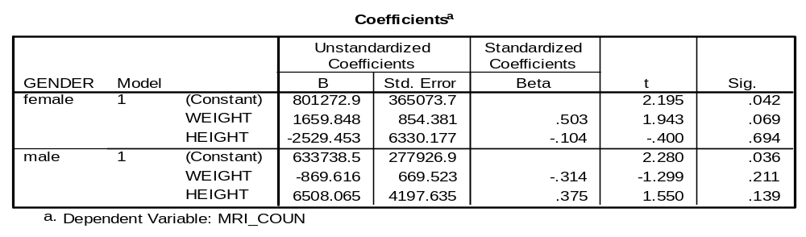
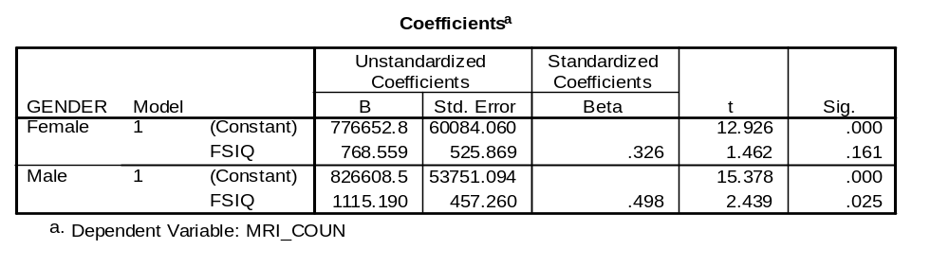

Slide 9



Slide 10
Strong Recommendations
For this analysis the data included a 28% response rate. Even though for some studies the response rate may be appropriate, to identify if indeed brain size and intelligence are related , a response rate of 70% or over would be the best choice to avoid any chance of bias, that is to ensure our results represent the entire student population at Oxford University in England;
If the populations consisted of 20,000 students to ensure a response rate of over 70% the data collector may select a sample size of about 14,000 students to obtain a 70% response rate.

